Slide 1

Session Initiation Protocol
RENAISSANCE SOFTLABS PVT. LTD.
www.renintech.com

Slide 2
Request Methods
INVITE “Would you like to chat?”
ACK “Thanks, received your confirmation. Let’s start chatting”
BYE “Okay, I’m ending the call now.”
CANCEL “Cancel that last request but don’t end the call”
OPTIONS “What functionality do you support?”
REGISTER “Direct all my calls to this phone.”
Enables Mobility
Notes:
43 possible headers

Slide 3
Responses
Provisional (1xx class)
1xx = provisional, searching, ringing, queuing etc.
Final (2xx, 3xx, 4xx, 5xx, 6xx classes)
  2xx = success
  3xx = redirection, forwarding
  4xx = request failure (client mistakes)
  5xx = server failures
  6xx = global failure (busy, refusal, not available anywhere)
Notes:
43 possible headers

Slide 4
Generating Request
Valid SIP Request
  Request URI
  To
  From
  CSeq
  Call Id
  Via
  Max-Forwards

Slide 5
Reason
Fundamental Building Blocks of Request
Jointly Provide
  Message Addressing
  Critical Routing Services
  Limiting Message Propagation
  Ordering of Messages
  Unique identification of Transaction

Slide 6
Mandatory Headers
To
To: The Operator <sip:operator@cs.columbia.edu>;tag=287447
t: sip:+12125551212@server.phone2net.com
From
From: "A. G. Bell" <sip:agb@bell-telephone.com> ;tag=a48s
From: sip:+12125551212@server.phone2net.com;tag=887s
From: Anonymous <sip:c8oqz84zk7z@privacy.org>;tag=hyh8
Max-Forwards
Max-Forwards: 6

Slide 7


Decrementing Max-Forwards
Max-Forwards:70
Max-Forwards:69
bob@msu.edu
alice@abc.com
bob@iptel.org
Max-Forwards:68
Max-Forwards:67
bob@pc4.cse.msu.edu
bob@cse.msu.edu

Slide 8
Mandatory Headers
CSeq
CSeq: 4711 INVITE
Call-ID
(uniquely identifies a particular invitation or all registrations)
Call-ID: f81d4fae-7dec-11d0-a765-00a0c91e6bf6@biloxi.com
Via
Via: SIP/2.0/UDP
erlang.bell-telephone.com:5060;branch=z9hG4bK87asdks7
Via: SIP/2.0/UDP 192.0.2.1:5060 ;received=192.0.2.207;branch=z9hG4bK77asjd

Slide 9
Response Routing
Via: i.iptel.org
Via: a.abc.com
Via: a.abc.com
Via: a.abc.com
Via: i.iptel.org
Via: a.abc.com
bob@msu.edu
alice@abc.com
bob@iptel.org
Via: sip.msu.edu
Via: i.iptel.org
Via: a.abc.com
Via: cse.msu.edu
Via: sip.msu.edu
Via: i.iptel.org
Via: a.abc.com
Via: sip.msu.edu
Via: i.iptel.org
Via: a.abc.com
Via: cse.msu.edu
Via: sip.msu.edu
Via: i.iptel.org
Via: a.abc.com
bob@pc4.cse.msu.edu
bob@cse.msu.edu

Slide 10
Provisional Responses (Informational)
Informational
100 Trying
180 Ringing
181 Call forwarded
182 Queued
183 Session Progress
Notes:
43 possible headers

Slide 11
Final Responses
Success
200 OK
Redirection
300 Multiple Choices
301 Moved Perm.
302 Moved Temp.
380 Alternative Serv.
Notes:
43 possible headers

Slide 12
Final Responses
Request Failure
400 Bad Request 401 Unauthorized
403 Forbidden 404 Not Found
405 Method not Allowed 415 Unsupp. Content
420 Bad Extensions 486 Busy Here
Notes:
43 possible headers

Slide 13
Final Responses
Server Failure
500 Server Error
501 Not Implemented
503 Unavailable
504 Timeout
Global Failure
600 Busy Everywhere
603 Decline
604 Doesn’t Exist
606 Not Acceptable
Notes:
43 possible headers

Slide 14
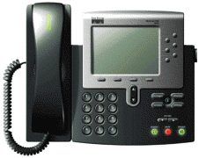
Simple Call Flow
INVITE
180 RINGING
200 OK
ACK
Bi-directional Media between endpoints
BYE
200 OK
Notes:
43 possible headers

Slide 15
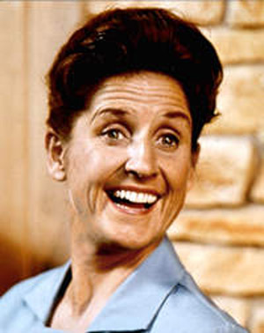


Call Flow with Proxy
SIP Server
INVITE
INVITE
100 Trying
180 Ringing
180 Ringing
200 OK
200 OK
ACK
Bi-directional Media between endpoints
BYE
BYE
200 OK
200 OK
Notes:
43 possible headers

Slide 16
INVITE Message
INVITE sip:bob@Atlanta.com SIP/2.0
To: Bob <sip: bob@ Atlanta.com>
From: Alice <sip:alice@Atlanta.com>;tag=1928301774
Call-ID: a84b4c76e66710@pc33.Atlanta.com
CSeq: 314159 INVITE
Via: SIP/2.0/UDP pc33.Atlanta.com;
Max-Forwards: 70
Contact: <sip:alice@pc33.Atlanta.com>
Notes:
43 possible headers

Slide 17
200 OK Message
SIP/2.0 200 OK
To: Bob <sip: bob@ Atlanta.com>; tag=a6c85cf
From: Alice <sip:alice@Atlanta.com>;tag=1928301774
Call-ID: a84b4c76e66710@pc33.Atlanta.com
CSeq: 314159 INVITE
Via: SIP/2.0/UDP bigbox3.site3.atlanta.com
Via: SIP/2.0/UDP pc33.atlanta.com
Contact: <sip:bob@192.0.2.4>
Content-Type: application/sdp
Content-Length: 131
Notes:
43 possible headers

Slide 18

Stateless Proxy
cse.msu.edu
abc.com
INVITE
jshapiro@cse.msu.edu
jks@bahia
jshapiro?
alice@abc.com
INVITE
jks@bahia.cse.msu.edu
bahia
200 OK
jks@bahia.cse.msu.edu
ACK
jks@bahia.cse.msu.edu
Notes:
43 possible headers

Slide 19
Register Call Flow
SIP Server
REGISTER
401 Unauthorized
REGISTER
200 OK
Notes:
43 possible headers

Slide 20
Redirect Call Flow
iptel.org
abc.com
jks@bahia
jshapiro?
INVITE
jshapiro@iptel.org
alice@abc.com
302 Moved temporarily
contact jshapiro@bahia.cse.msu.edu
INVITE
jshapiro@cse.msu.edu
200 OK
jks@bahia.cse.msu.edu
cse.msu.edu
ACK
jks@bahia.cse.msu.edu
bahia
Notes:
43 possible headers

Slide 21
Message Call Flow
MESSAGE
200 OK
MESSAGE
200 OK
Notes:
43 possible headers

Slide 22
Other Headers
Alert-Info
Alert-Info: http://www.example.com/sounds/play.au
Allow
Allow: INVITE, ACK, OPTIONS, CANCEL, BYE
Authorization
Authorization: Digest username="Alice", realm="atlanta.com"

Slide 23
Other Headers
Call-Info
Call-Info: <http://wwww.example.com/alice/photo.jpg>
;purpose=<icon><info><card>,
<http://www.example.com/alice/> ;purpose=info
Contact
Contact: "Mr. Watson" <sip:watson@worcester.bell- telephone.com>; expires=3600,
"Mr. Watson" <mailto:watson@bell-telephone.com> ;expires=60

Slide 24
Other Headers
Content-Encoding
Content-Encoding: gzip
Content-Language
Content-Language: fr
Content-Length
Content-Length: 349
Content-Type
Content-Type: application/sdp

Slide 25
Other Headers
Date
Date: Sat, 13 Nov 2010 23:29:00 GMT
Error-Info
SIP/2.0 404 The number you have dialed is not in service
Error-Info: <sip:not-in-service-recording@atlanta.com>
Expires
Expires: 5

Slide 26
Other Headers
Organization
Organization: Boxes by Bob
Priority
Subject: A tornado is heading our way!
Priority: emergency
Priority: non-urgent
Priority: normal
Priority: urgent
Record-Route
Record-Route: <sip:server10.biloxi.com;lr>,
<sip:bigbox3.site3.atlanta.com;lr>

Slide 27
Other Headers
Retry-After 500 (Server Internal Error) or 503 (Service Unavailable)
Retry-After: 120 (I’m in a meeting)
Subject
Subject: Need more boxes
Supported
Supported: MESSAGE

Slide 28
Other Headers
Unsupported
Unsupported: CONF
User-Agent
User-Agent: Softphone Beta1.5

Slide 29
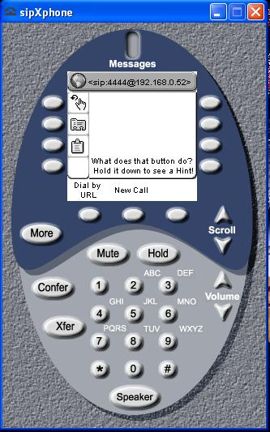
User Agent Examples

Slide 30
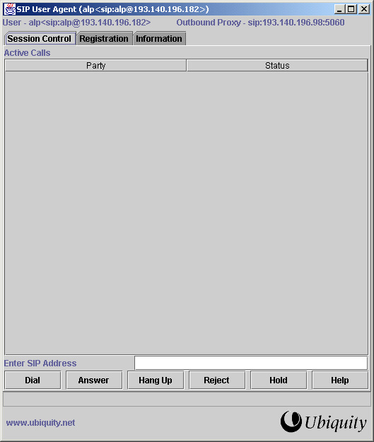

Slide 31
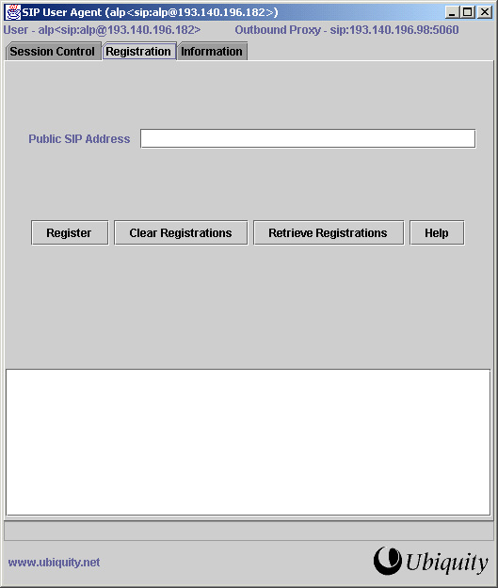

Slide 32
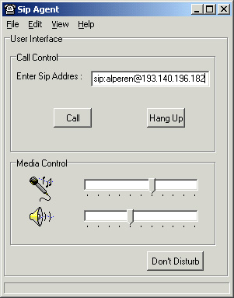

Slide 33
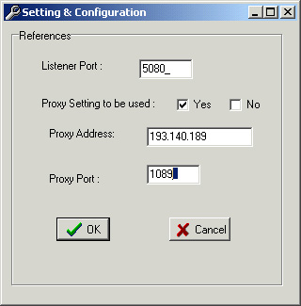
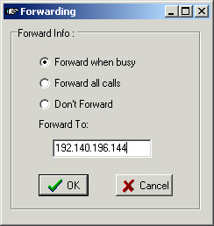

Slide 34
